Slide 1
Analysis of clustering methodologies on Colorectal Cancer samples
“A study on Colorectal cancer samples aiming at the comparison between which clustering methodology is better to use with a specific type of data, while trying also to uncover new information that can be used for treatment purposes”
Andrea Policano 28/11/2024

Slide 2
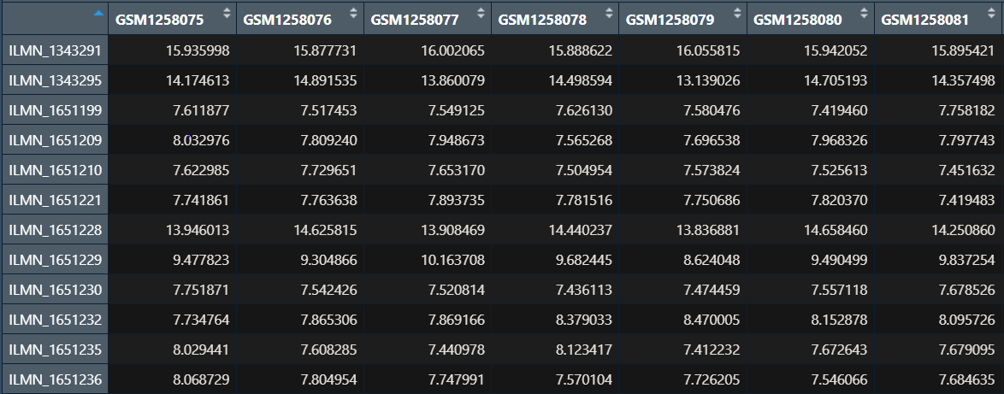
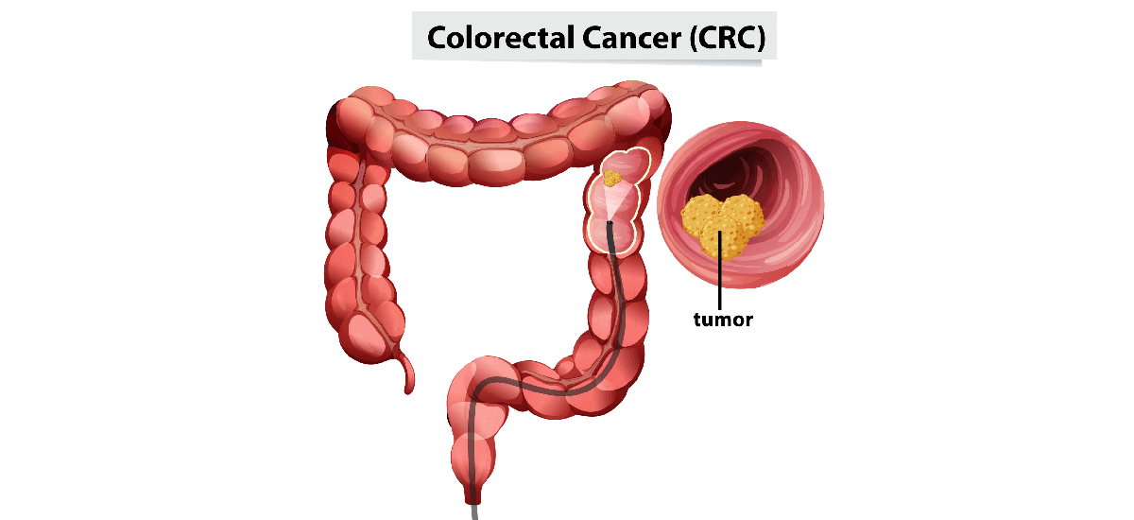
What are we working with?
GSE52060 dataset
Related to CRC
23 samples for each type of tissue
Neoplastic vs Normal Mucosa
Colorectal Cancer
Colon section of the Intestine
Presence of polyps
Many symptoms and risk factors associated to it

Slide 3

Main quest
1
2
3
4
Apply different clustering methodologies
Compare them to study efficacy and efficiency
Execute enrichment analysis
Discuss results

Slide 4
Which clustering technique were used?
PCA
K-means
Hierarchical Clustering
RF
LASSO
LDA
RSCUDO

Slide 5
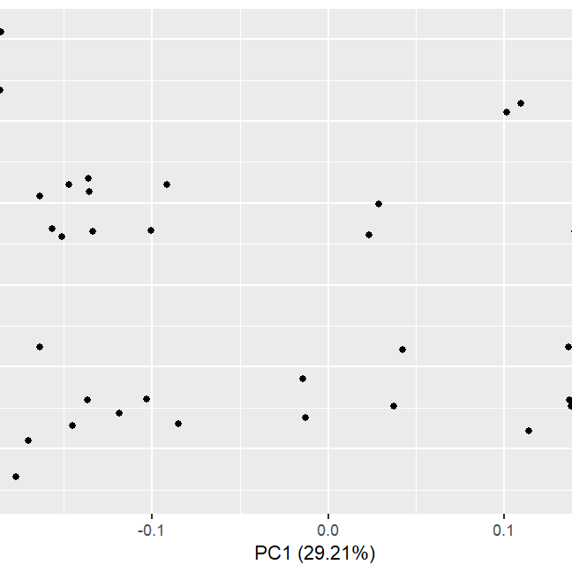
RESULTS
1.
After the application of the different clustering methodologies check the results obtained
Take a look at how the samples are classified using the different algorithms

Slide 6
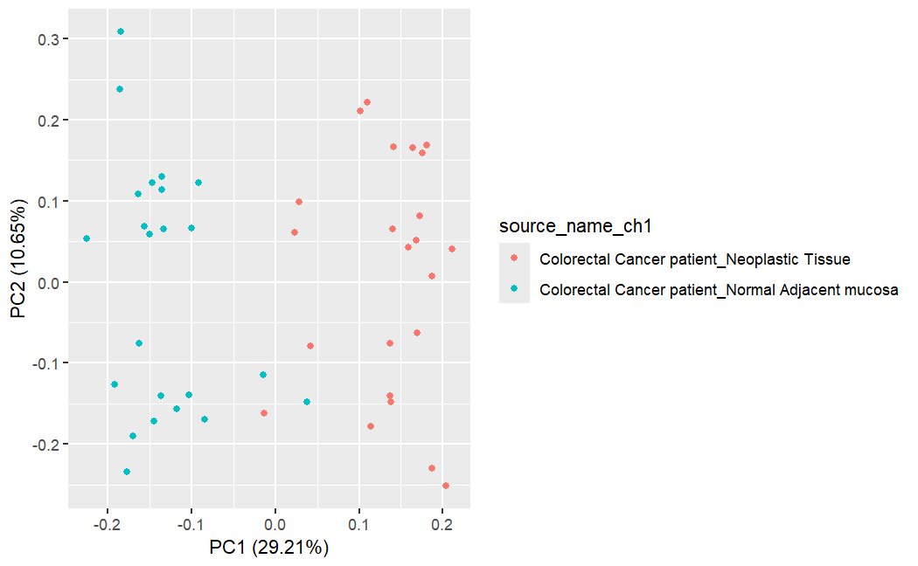
1.
PCA

Slide 7
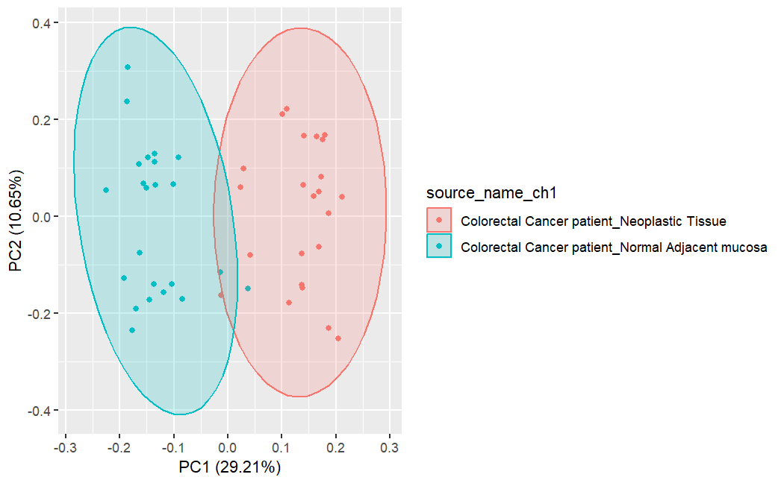
1.
PCA

Slide 8
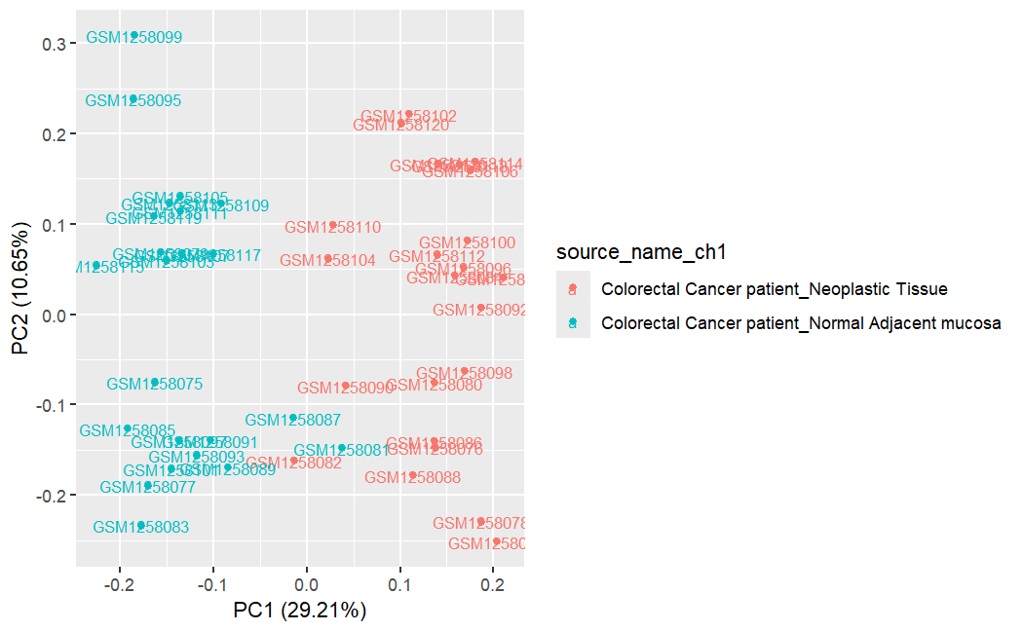
1.
PCA

Slide 9
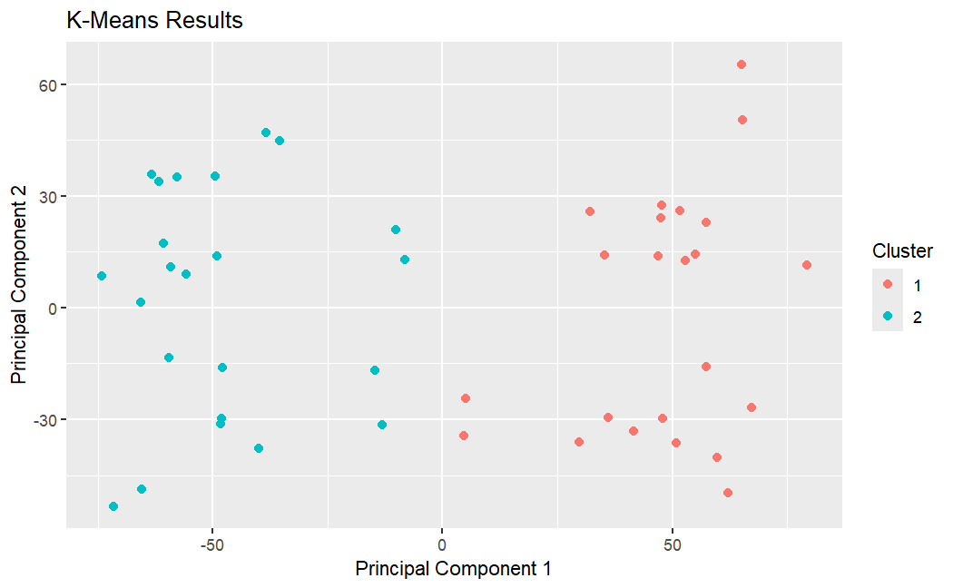
1.
K-MEANS

Slide 10
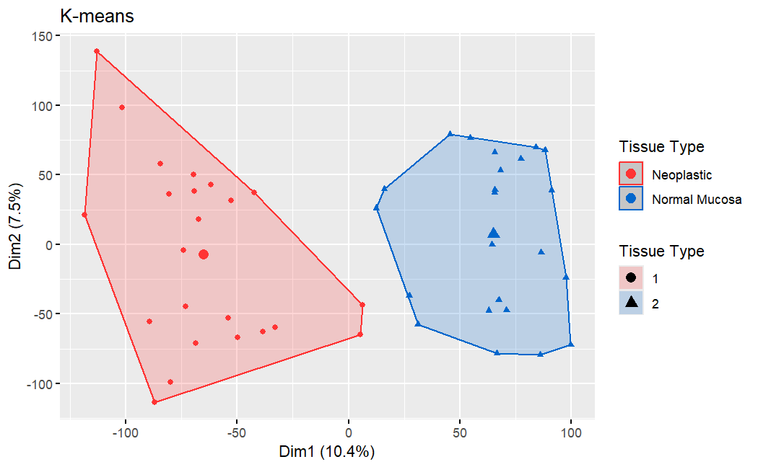
1.
K-MEANS

Slide 11
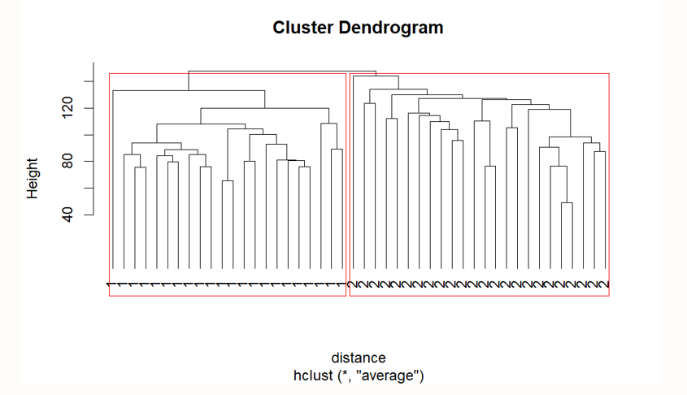
1.
HIERARCHICAL CLUSTERING

Slide 12
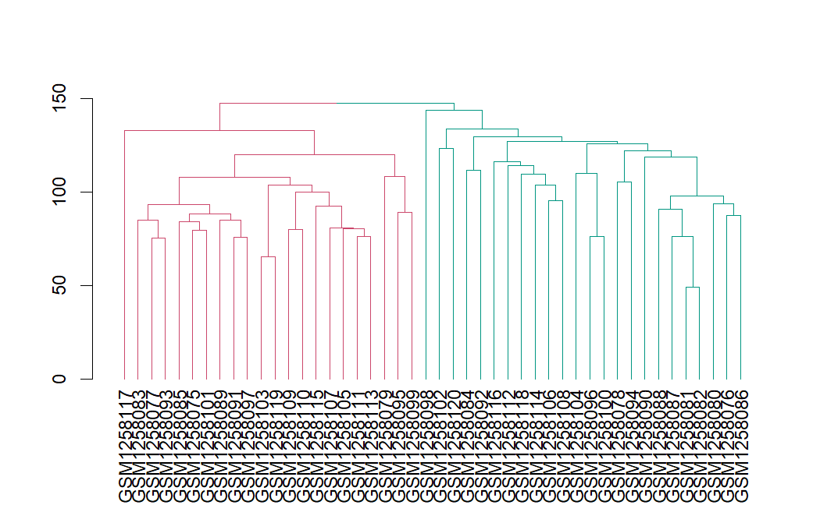
1.
HIERARCHICAL CLUSTERING

Slide 13
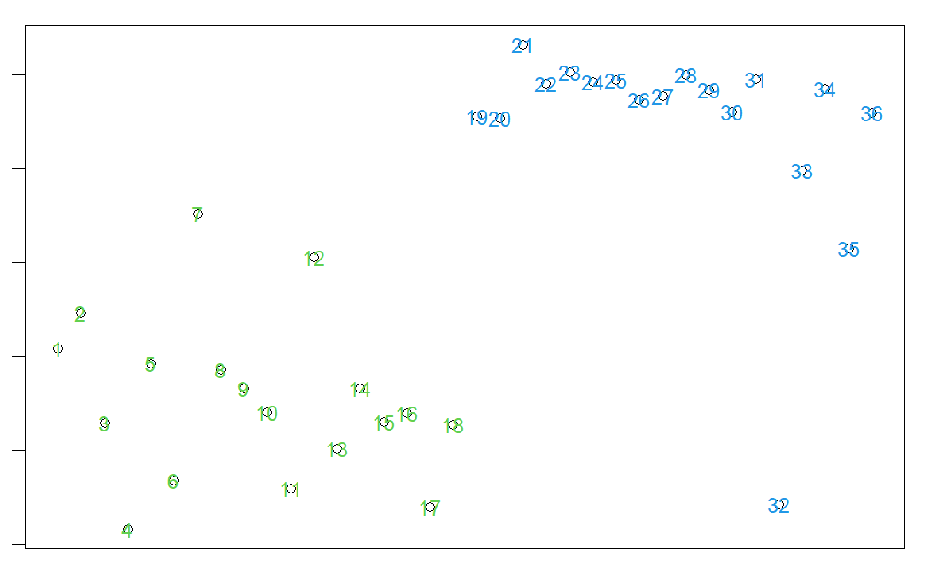
1.
LDA (Linear Discriminant Analysis)

Slide 14
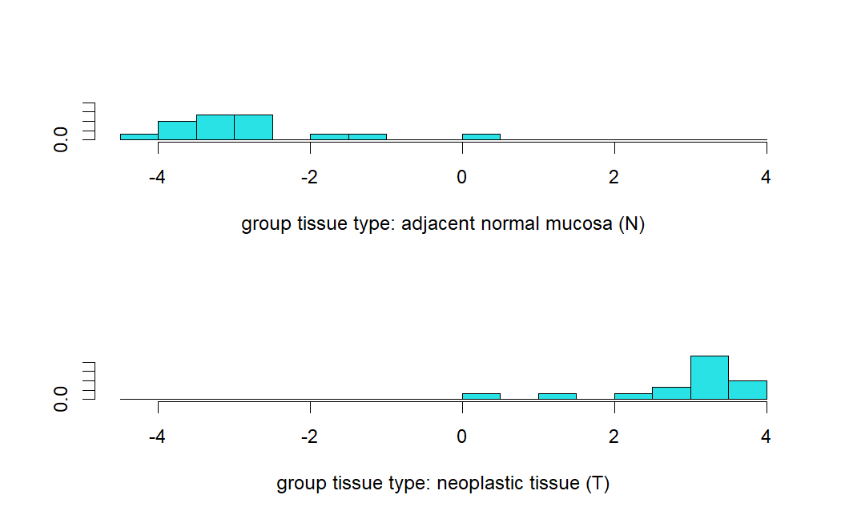
1.
LDA (Linear Discriminant Analysis)

Slide 15
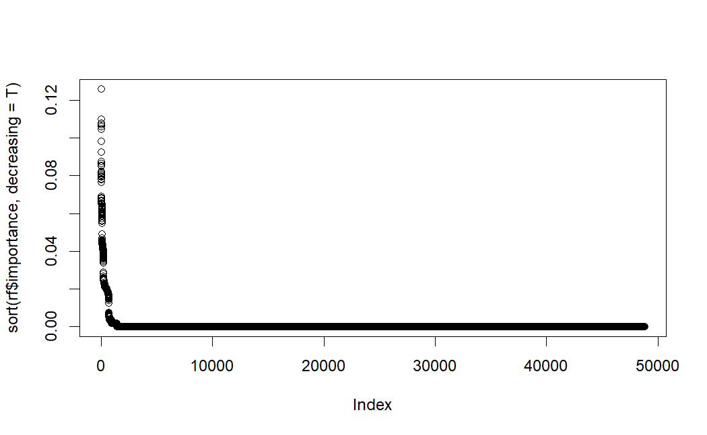
1.
RF (Random forest)

Slide 16
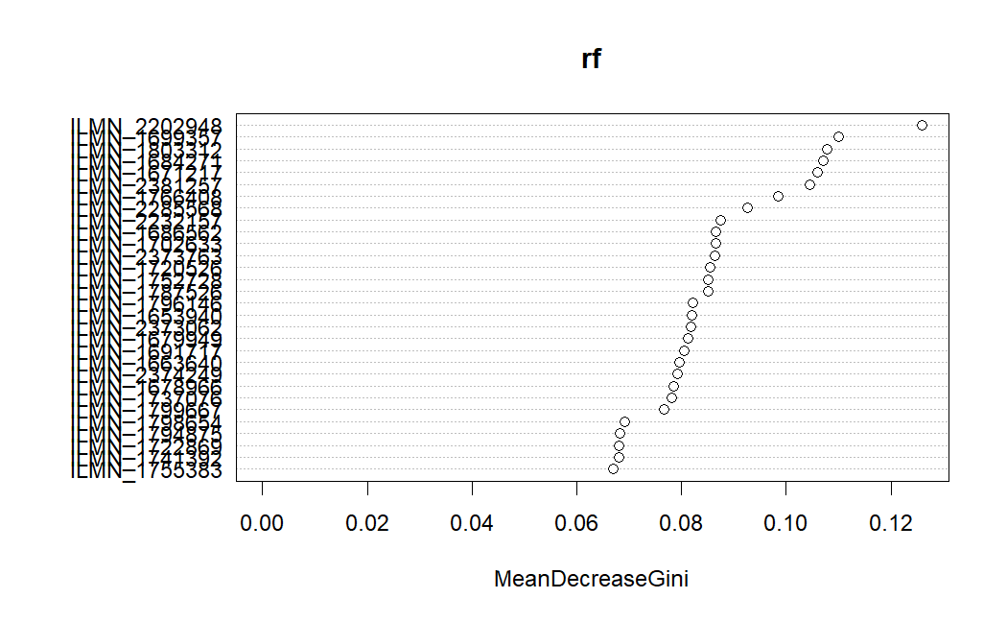
1.
RF (Random forest)

Slide 17
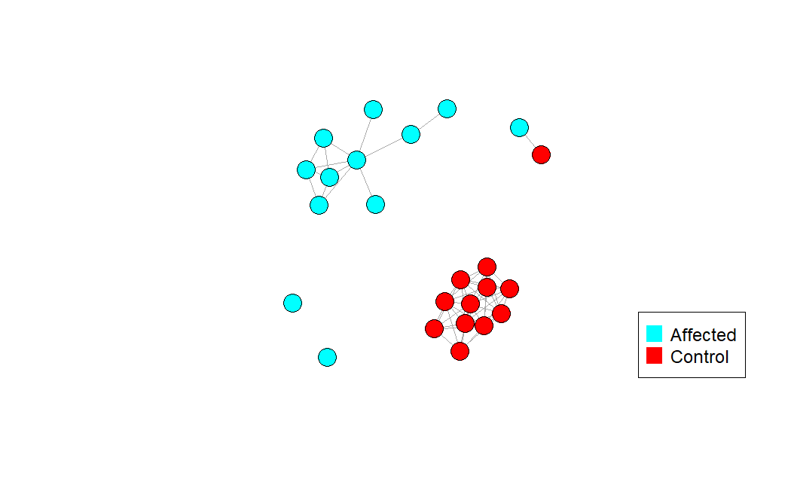
1.
RSCUDO

Slide 18
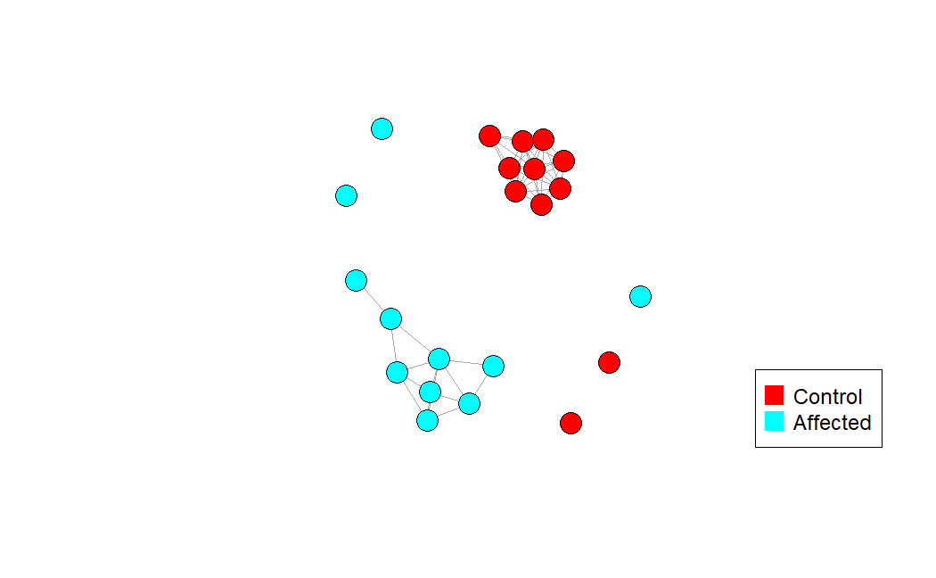
1.
RSCUDO

Slide 19
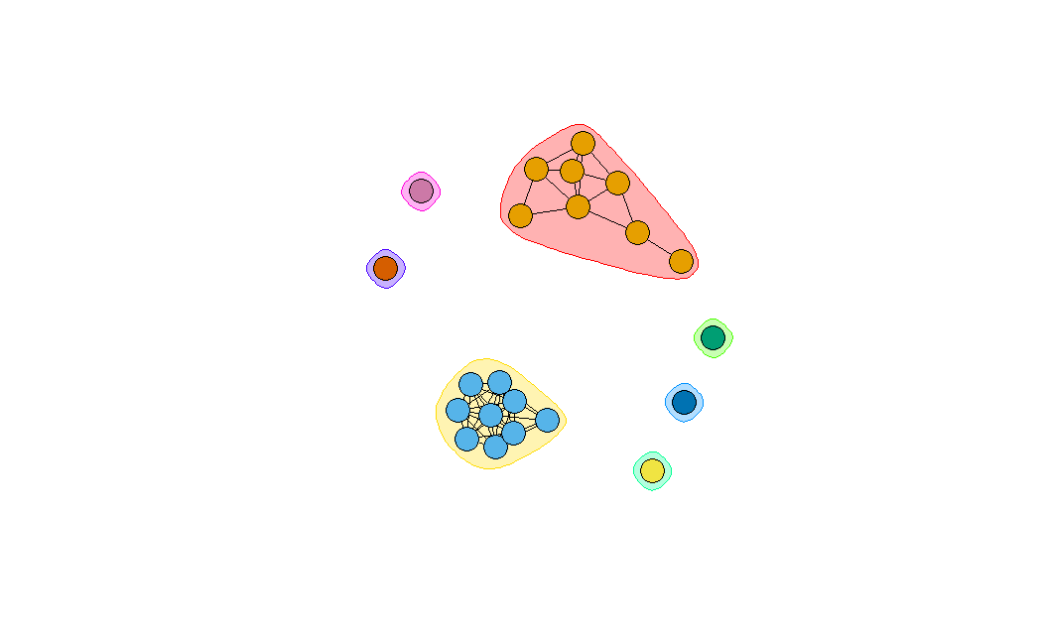
1.
RSCUDO

Slide 20
COMPARISON
2.
Compare the models and their efficacy
See which is better given the situation and the dataset used for this particular occasion

Slide 21
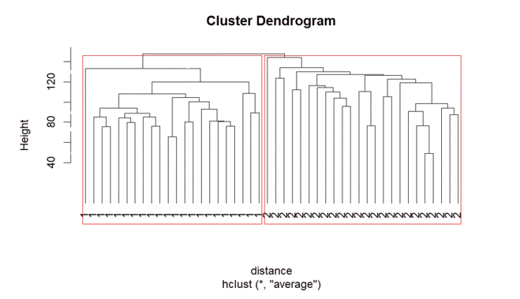
2.
COMPARISON
Compare how the different methodologies do in terms of effective clustering and if there are any errors, if possible, analyse the quality
PCA : almost a perfect clustering except for 2 datapoints present at the bottom of the plot
K-means : perfect clustering of the samples, useful in order to understand also which were the anomalies in the PCA plot
Hierarchical Clustering : perfect clustering with representation of the sample’s relationships as branch distance

Slide 22
2.
COMPARISON
RF : did a good job for the classification of the samples and when subjected to multiple trials its accuracy increases
LDA : performed well in the clustering and with repeated trials still holds high accuracy
LASSO : this algorithm, among all the others, was the one with the lowest accuracy
RSCUDO: good level of classification with few nodes that were left on their own (solitary ones)

Slide 23
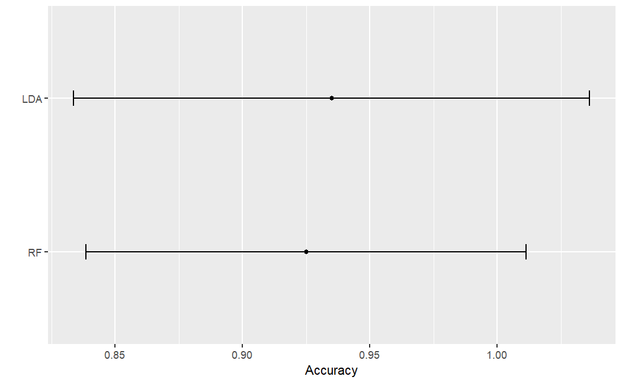
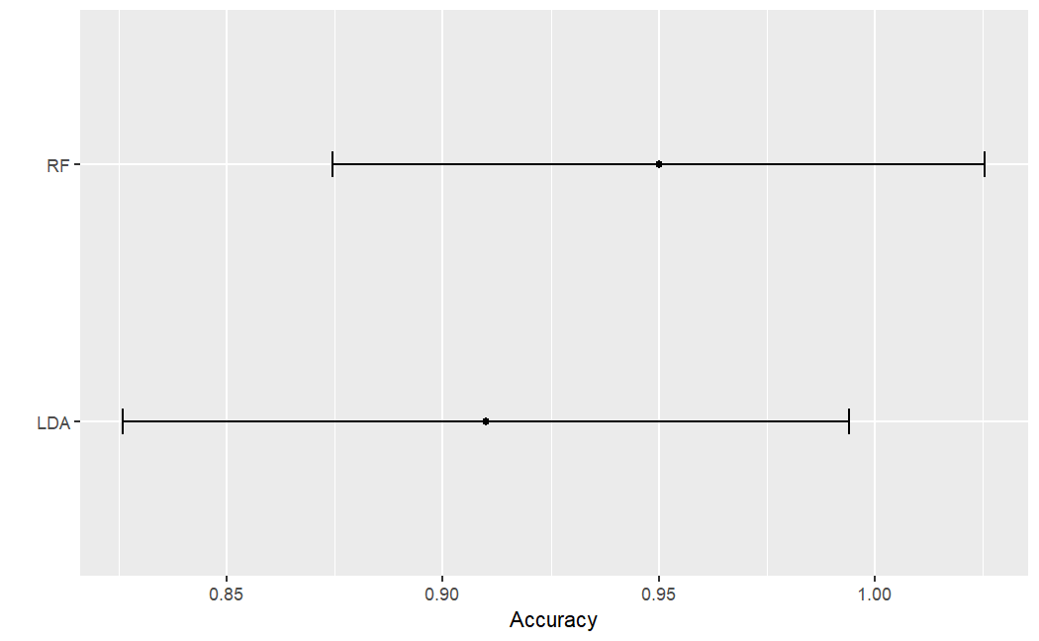
2.
COMPARISON
1 TRIAL
10 TRIALS

Slide 24
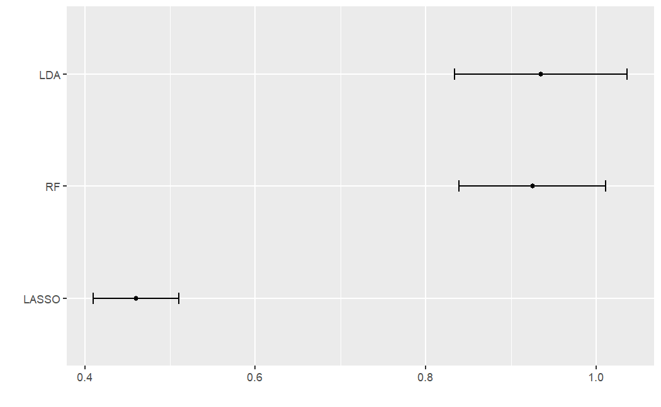
2.
COMPARISON
10 TRIALS

Slide 25
DISCUSSION
3.
Discuss in general the results obtained
Elaborate the findings

Slide 26
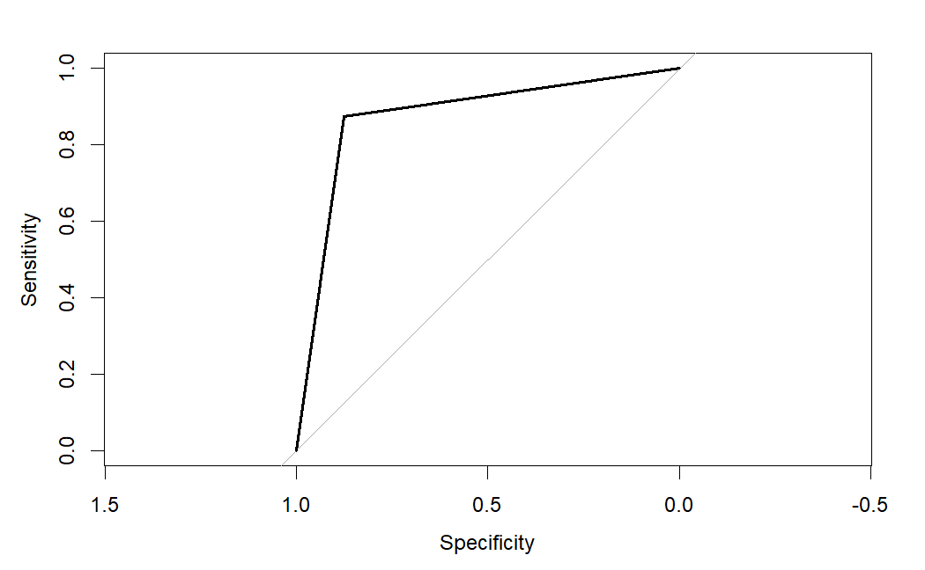
3.
DISCUSSION
Special focus on the LDA methodology as it is also able to be applied for more complex models and approaches
Quality check and effect of values modification on the technique
ROC curve value ~0.88

Slide 27
3.
DISCUSSION
Random forest faired quite well in the classification, while also noting the probes with major relevance in the process

Slide 28
3.
DISCUSSION
Random forest faired quite well in the classification, while also noting the probes with major relevance in the process

Slide 29
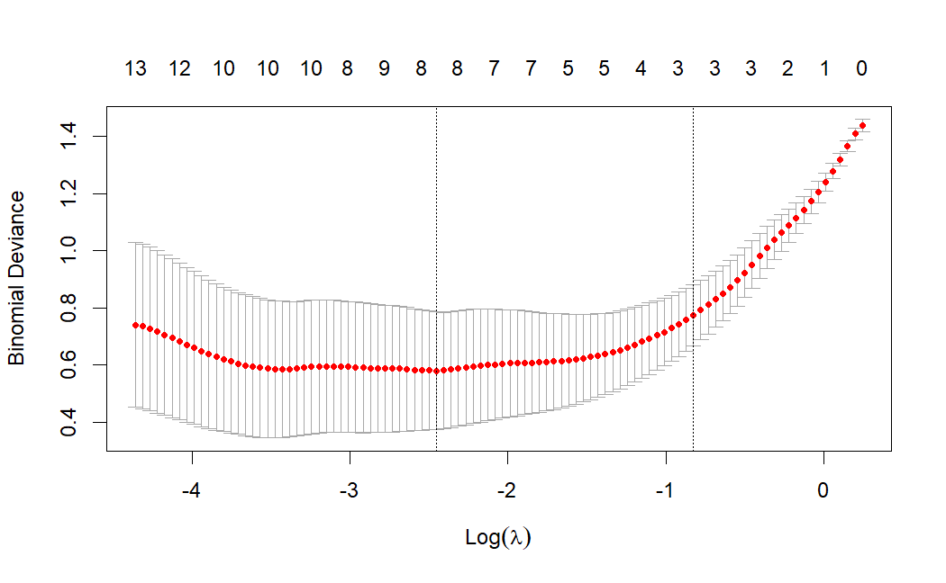
3.
DISCUSSION
As seen before the application of LASSO did not pay off as much as the other methodologies, in addition to that the Binomial deviance is already high on its own

Slide 30
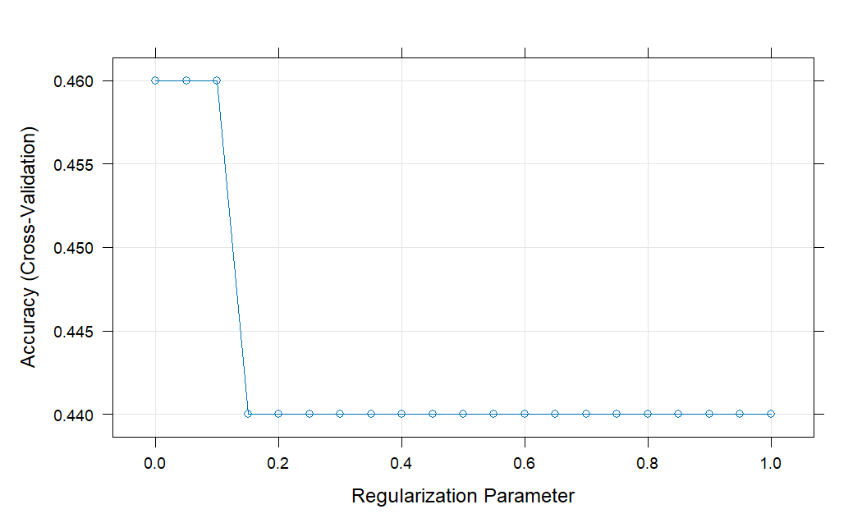
3.
DISCUSSION
Even with the implementation of different regularization parameter the results re no better

Slide 31
3.
DISCUSSION
Annotate how the methodologies fared in the task assigned to them
PCA : Good
K-means : Perfect
Hierarchical Clustering : Perfect
RF : Very Good
LDA : Very Good
LASSO : Poor performance
RSCUDO : Good

Slide 32
ENRICHMENT
4.
Execute enrichment analysis on filtered obtained genes
Application of STRING db for further investigation

Slide 33
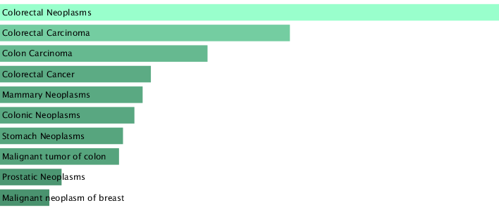
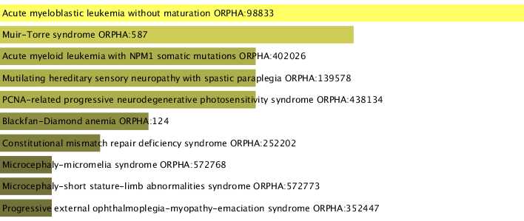
4.
ENRICHMENT
Enrichment plots derived by the disease section of EnrichR online tool
The procedure was applied on the list of filtered genes starting from the original dataset

Slide 34
4.
ENRICHMENT
27,3%
8,84%
Filtering : genes with p-value < 0.05
Filtering : genes having a description in EnrichR

Slide 35
4.
ENRICHMENT
Conduction of Enrichment analysis and use of the filtered gene list in STRING database in order to obtain more insights that could be used
Use of STRING database on the remaining elements of the filtering in order to produce a protein-protein network of the associated genes

Slide 36



4.
PATHFINDER
Throughout the study PathfindR was also implemented to retrieve additional enrichment data, coming from different databases/ontologies. In this project the one considered were:
KEGG
GO-BP
Reactome

Slide 37
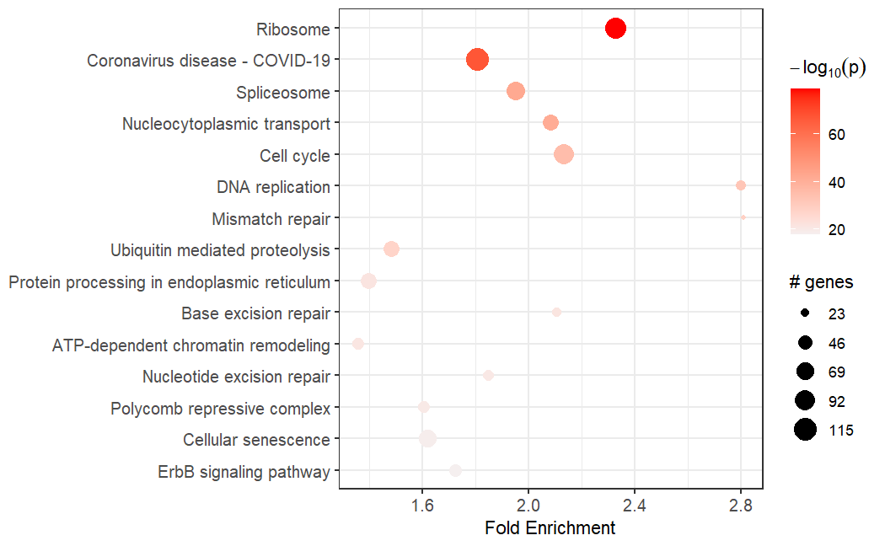
4.
PATHFINDER
KEGG

Slide 38
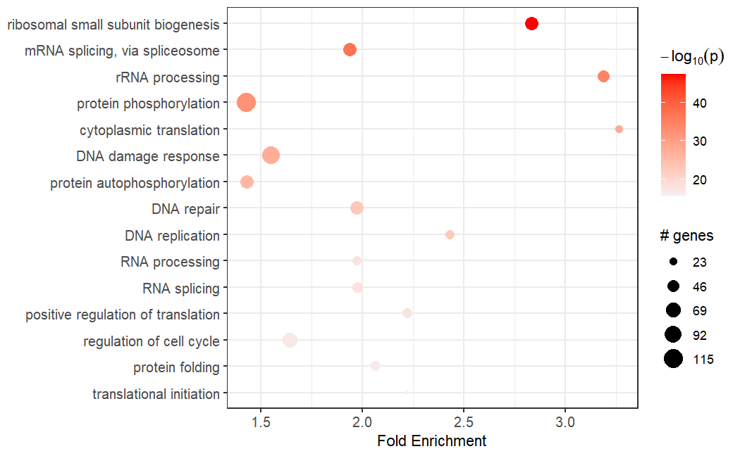
4.
PATHFINDER
GO-BP

Slide 39
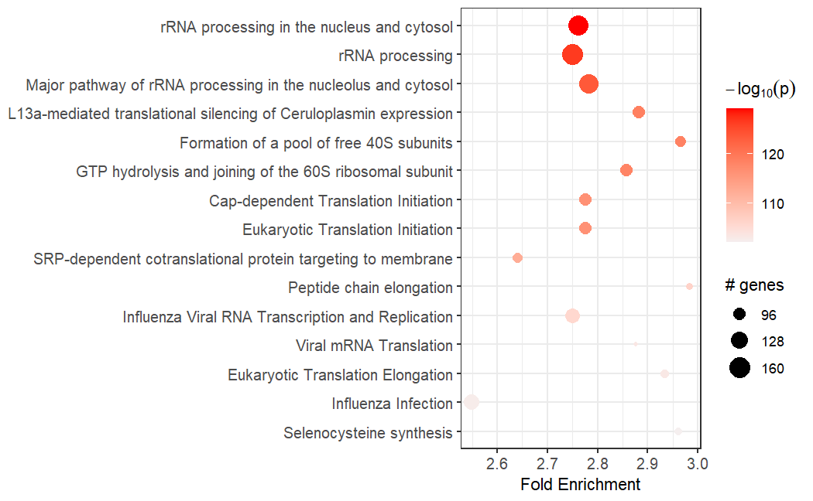
4.
PATHFINDER
Reactome

Slide 40

Final considerations
Presence of un- and expected results coming from the enrichment
Need for further validation regarding the methodologies and the results
Well constructed network with the presence of “solitary” interaction-lacking nodes
Some enrichment results may be used in order to consider some starting point for additional studies to find weak points of the illness for a better treatment of it

Slide 41
THANK YOU FOR YOUR ATTENTION

